Slide 1
Responding to Challenging Situations
Developed by:
University of Wisconsin Oshkosh
Center for Community Development, Engagement and Training (CCDET)
Wisconsin Department of Health Services
Division of Quality Assurance (DQA)
www.uwosh.edu/caregiver
September 2018

Slide 2
Introduction
Learning Points
As caregivers, we frequently find ourselves in the position of caring for a resident whose behaviors are difficult to understand
By improving our skills, we will become more successful in responding to the challenges we encounter
Activity: Think of a Challenging Situation

Slide 3
Recognizing Unmet Needs
First steps
Is there a pattern?
Other helpful strategies
Walk in the shoes of the resident

Slide 4
Cognitive and Environmental Changes
Thinking Processes
-Scenarios
Physical Changes
-Scenarios

Slide 5
Three Steps to Person-Centered Care
Step 1: Define the Situation | Step 2: Explore the Possible Cause | Step 3: Offer a Person-Centered Approach

Slide 6
Common Behaviors, Possible Causes, Person-Centered Approaches
Review the handout briefly
Activity: Person-Centered Responses to Challenging Situations
Life Histories:
Marian Rossi
Juan Escamilla
Carol Jacobsen

Slide 7
The Reason Behind the Behavior
There is usually a reason behind the actions of a person living with dementia
Looking for the “Wise Reason”
Learn the rest of the story
Helping a resident to feel special and unique promotes self-esteem and is the key to providing the best care possible.

Slide 8
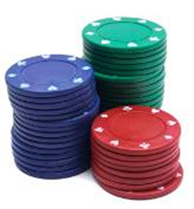
Building Self-Esteem
The Poker Chip Theory
Simple Solutions
When we can fulfill people’s emotional needs, they don’t have to withdraw into the past. They can risk a few poker chips by interacting in the present.

Slide 9
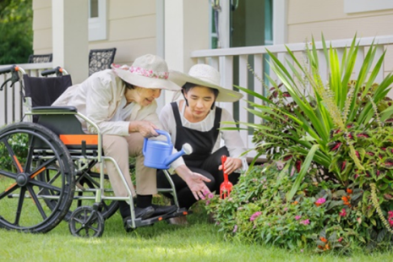
Workshop Closing
Review Learning Points
Recognize common challenging behaviors that result from changes in the brain due to dementia
Interpret common messages the person living with dementia may be communicating through behavior
Design person-centered responses to meet the unique needs of people living with dementia
For additional training opportunities: www.uwosh.edu/caregiver
or email caregiver@uwosh.edu

Slide 10
developed by
The Wisconsin Caregiver Project
UW Oshkosh
Center for Community Development, Engagement and Training (CCDET)
www.uwosh.edu/ccdet/caregiver

