Slide 1
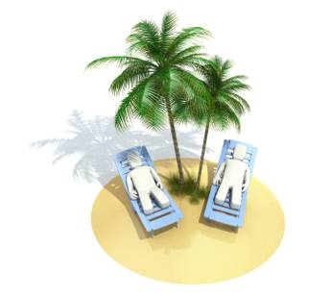
Stress Reduction and Relaxation Techniques
Developed by the:
University of Wisconsin Oshkosh
and
Wisconsin Department of Health Services

Slide 2
Learning Points
Recognize our reactions to stress
Explore techniques for stress relief
Incorporate stress reduction practices into our daily lives

Slide 3
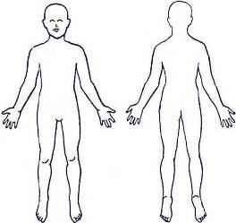
Your Body’s Response to Stress
The Fight or Flight Response
Recognizing the Signs of Stress
Activity: Locating the Stress in Your Body

Slide 4
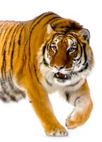
More About Stress
Saber-Tooth Tigers
Reducing Stress
How might a stressed caregiver behave or respond to a challenging resident?
What are some approaches that a caregiver can take immediately when a situation with a resident or client seems out of control?

Slide 5
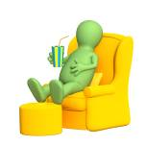
Reducing Stress Symptoms
What Do You Do to Relax?
Peaceful Reality: Banish Negative Thought Patterns

Slide 6
More Stress Reducing Practices
Muscle Relaxation
Physical Exercise
Meditation
Breathing
Self-Acupressure
Finger Holds
Tai Chi & Yoga
Journaling
Seven Quickies
Personal Network Profile
Choose an Exercise: Which Appeals Most to You?

Slide 7
Learning Points Review
Recognize our reactions to stress
Explore techniques for stress relief
Incorporate stress reduction practices into our daily lives

Slide 8
developed by
The Wisconsin Caregiver Project
UW Oshkosh
Center for Community Development, Engagement and Training (CCDET)
www.uwosh.edu/ccdet/caregiver

